Slide 1
EDUPRO ELITE OS
DEVELOPER IMPLEMENTATION BLUEPRINT
A complete technical guide to building and compiling the full-stack AI-enabled school management platform. Relational configurations, API schemas, security layers, and source snippets.
DEVELOPERS
Ankit Kumar Dubey (2211108) Sukumar Gope (2211157) Ravikant Mahto (2211135) Aryan Kumar (2211146) Abhijeet K. Prajapati (2211102)
PROJECT SUPERVISOR
Mr. Sumeet Kumar (Assistant Professor) Mr. Awadhesh Kumar (H.O.D)
UCET, Vinoba Bhave University B.Tech Information Technology Session: 2022 - 2026

Slide 2
SYSTEM IMPLEMENTATION ROADMAP
Phase 1: DB Config
Install MySQL and construct relation schemas with foreign cascades.
Phase 2: Backend API
Initialize Node/Express, set connection pools, write endpoints.
Phase 3: JWT Security
Secure express endpoints using token authentication middleware.
Phase 4: Client Core
Build Vite-React framework, bind APIs using Axios interceptors.
Build Strategy & Quality Checks
• Modular Development: Enables clean separation of frontend components and Express routes to simplify debugging and scaling.
• Seed Testing: Uses automatic database seeders during local runs to quickly generate mock data without manual entry.
• Integrity Assurances: MySQL foreign key constraints ensure deleting records (such as students) clean up related tables automatically.

Slide 3
PHASE 1: DATABASE SCHEMA BLUEPRINT
Relational Table Schema Design
• Database normalization: Organizes data into isolated tables (users, students, teachers, attendance, fees, etc.) to minimize duplicate fields.
• Foreign Key Cascades: Creates links between students and related tables (attendance, fees, library) to handle deletions safely.
• Role Enumeration: Defines user roles strictly as enum('admin', 'teacher', 'student', 'parent') for permission security.
• Data Types Choice: Uses primary key string indices (VARCHAR) for student_id/teacher_id, decimal fields for fees collection, and date-time indices.
// database.sql (Relational Core)
CREATE DATABASE IF NOT EXISTS school_db;
USE school_db;
CREATE TABLE users (
id INT AUTO_INCREMENT PRIMARY KEY,
name VARCHAR(100) NOT NULL,
email VARCHAR(100) UNIQUE NOT NULL,
password VARCHAR(255) NOT NULL,
role ENUM('admin','teacher','student','parent'),
profilePic TEXT,
created_at TIMESTAMP DEFAULT CURRENT_TIMESTAMP
);
CREATE TABLE students (
student_id VARCHAR(20) PRIMARY KEY,
name VARCHAR(100) NOT NULL,
class_id INT,
section_id INT,
FOREIGN KEY (class_id) REFERENCES classes(class_id)
);

Slide 4
PHASE 2: DATABASE SETUP & SEEDING
Bootstrapping Database via Code
• Startup seeding script: Executes when the Express API server boots up, ensuring the target database and tables exist automatically.
• Laragon & XAMPP support: Connects directly using local credentials (root/no password) and handles port 3306 configurations.
• Verification logic: Checks if table records exist (e.g. admin@school.com) and seeds mock profiles if tables are empty.
• Graceful error handling: Tries to reconnect if SQL services are inactive on launch, printing clear troubleshooting logs.
// config/dbInit.js (Auto Seeder)
const mysql = require('mysql2/promise');
const initDb = async () => {
const dbName = process.env.DB_NAME || 'school_db';
const connection = await mysql.createConnection({
host: process.env.DB_HOST || '127.0.0.1',
user: process.env.DB_USER || 'root',
password: process.env.DB_PASSWORD || ''
});
await connection.query(
`CREATE DATABASE IF NOT EXISTS ${dbName}`
);
await connection.query(`USE ${dbName}`);
// Loop and execute table creations...
await connection.query(`INSERT INTO users...`);
};
module.exports = initDb;

Slide 5
PHASE 3: EXPRESS BACKEND GATEWAY
Express App & Middleware Configurations
• JSON Parser: Enables `app.use(express.json())` middleware to handle REST payloads safely.
• CORS Policy: Integrates cross-origin middleware to allow connection requests from the React frontend port (5173).
• Connection Pooling: Creates a MySQL query connection pool to optimize parallel queries and prevent connection leaks.
• Start sequences: Calls `initDb()` first to verify database schemas before activating listeners on port 5000.
// server.js (Boilerplate Configuration)
const express = require('express');
const mysql = require('mysql2/promise');
const cors = require('cors');
const initDb = require('./config/dbInit');
const app = express();
app.use(cors());
app.use(express.json());
const pool = mysql.createPool({
host: process.env.DB_HOST || '127.0.0.1',
user: process.env.DB_USER || 'root',
database: process.env.DB_NAME || 'school_db',
connectionLimit: 10
});
initDb().then(() => {
app.listen(5000, () => console.log('API Live!'));
});

Slide 6
REST API ENDPOINTS: CORE SERVICES
Authentication & Status APIs
• POST /api/login: Validates email/password against user table. Returns signed JWT tokens and role properties.
• POST /api/register: Inserts new user profiles into the users database.
• GET /api/stats: Fetches aggregate counts of active students, registered teachers, notice counts, and financial caches for dashboards.
Directory Registers APIs
• GET /api/students: Fetches database student profile listings.
• POST /api/students: Registers student profiles with class mappings.
• DELETE /api/students/:id: Triggers cascading deletion queries to clean up attendance, marks, fees, and hostel records first.
• GET /api/teachers: Fetches user listings filtered by role = 'teacher'.
• POST /api/teachers: Inserts credentials with qualification, experience, and class assignments.

Slide 7
REST API ENDPOINTS: OPERATIONS
Academic & Operational Endpoints
• GET | POST /api/attendance: Logs student attendance (Present, Absent, Late) mapped to specific dates.
• GET | POST /api/exams: Schedules exam blocks and maps them to academic classes.
• GET | POST /api/timetable: Manages subject assignments and assigns teachers to prevent collisions.
Logistics & Communication Endpoints
• GET | POST /api/fees: Monitors student transaction ledgers, sorting by Paid vs Unpaid statuses.
• GET | POST | DELETE /api/hostel: Logs student room block occupancy allocations and vacancy balances.
• GET | POST /api/library: Mainages book listings and tracks available vs issued resource indicators.
• GET | POST | DELETE /api/notices: Broadcasts notices targeting parent, student, or teacher roles.

Slide 8
PHASE 4: JWT SECURITY MIDDLEWARE
Role Verification & Guard Logic
• Stateless Security: JWT tokens encode user IDs and roles, verifying access permissions on every backend route check.
• Authorization Middleware: Express routes are protected by a verification function. It checks the HTTP header payload before executing SQL queries.
• Payload Parsing: Decodes role signatures to prevent students or parents from editing marks, logs, or notice boards.
• Security boundaries: Restricts operations. Teachers can only edit marks, Parents can only view grades, and Admins handle configs.
// middleware/auth.js (JWT Middleware)
const jwt = require('jwt-simple');
const secret = process.env.JWT_SECRET;
const checkRole = (allowedRoles) => {
return (req, res, next) => {
const auth = req.headers['authorization'];
const token = auth && auth.split(' ')[1];
if (!token) return res.sendStatus(401);
try {
const payload = jwt.decode(token, secret);
if (!allowedRoles.includes(payload.role)) {
return res.sendStatus(403);
}
req.user = payload;
next();
} catch (e) { res.sendStatus(403); }
};
};

Slide 9
PHASE 5: FRONTEND VITE SETUP
Vite Project Initialization & Dependencies
• Vite React Client: Creates a fast React project using `npm create vite@latest` for swift reloading.
• Clean directory layout: Organizes pages (dashboards, directories) and reusable components (sidebars, tables, topbars) neatly.
• Styling system: Custom custom styling using `index.css` to build clean layouts without heavy Tailwind dependencies.
• Dynamic charting: Installs Recharts library (`recharts`) to display analytical statistics dynamically.
// Frontend Directory Structure
# Initialize client folder
npx -y create-vite@latest school-frontend \
--template react
cd school-frontend
# Install production dependencies
npm install axios react-router-dom lucide-react
npm install recharts framer-motion
# Target Directory Layout
src/
├── components/ # Topbar.jsx, Sidebar.jsx
├── pages/ # Students.jsx, Fees.jsx
├── services/ # service.jsx (Axios API)
├── App.jsx # Routing paths
└── main.jsx # Entry point

Slide 10
PHASE 6: AXIOS SECURITY INTERCEPTOR
Axios Request & Response Interceptors
• Automatic Header Injection: Requests check for stored JWT keys and inject them into headers, ensuring seamless validation.
• Unified response handler: Monitors incoming error payloads from backend routes.
• Token Expiry redirects: Detects HTTP 401 Unauthorized codes, clears local storage variables, and redirects users to the login screen.
• Stateless storage sync: Saves active user email, name, role, and avatar url inside localStorage upon successful login API responses.
// src/services/service.jsx (Axios API)
import axios from 'axios';
const API_URL = 'http://localhost:5000/api';
// Inject JWT token into every request
axios.interceptors.request.use(config => {
const token = localStorage.getItem('token');
if (token) {
config.headers.Authorization = `Bearer ${token}`;
}
return config;
});
// Handle token expiration errors globally
axios.interceptors.response.use(
res => res,
error => {
if (error.response?.status === 401) {
localStorage.clear();
window.location.href = '/login';
}
return Promise.reject(error);
}
);

Slide 11
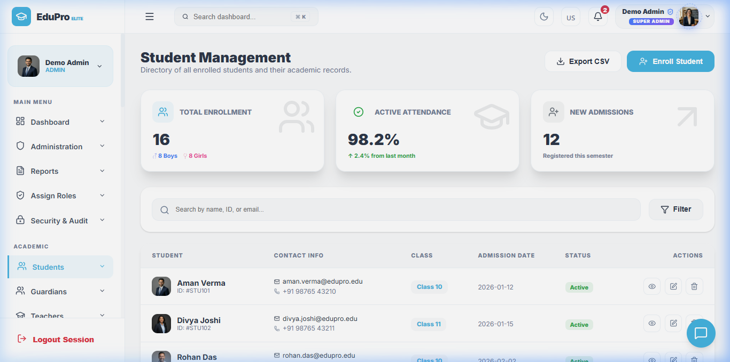
PHASE 7: DYNAMIC STUDENTS DIRECTORY
React Component Lifecycle & API Triggers
• Lifecycle hooks: Uses React's `useEffect` hook to trigger `getStudents()` async actions on mount.
• Local state bindings: Stores student profiles in a local React state (`useState`) to automatically update table listings.
• Loader overlays: Includes loading overlays to indicate query executions during server delays.
• Cascading actions: Deletions trigger requests to `/api/students/:id`, and then update local array cache filtering out deleted IDs.
Live Web Portal Interface
Figure 7.1: Frontend Students Directory showing student rosters, status tags, class filters, and dynamic profile avatars.

Slide 12
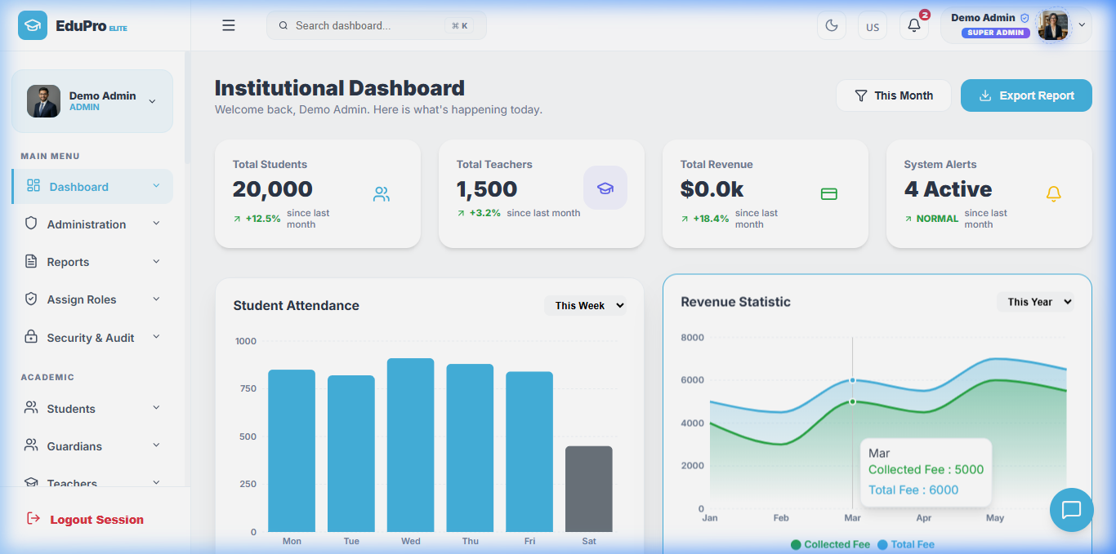
PHASE 8: SUPER ADMIN DASHBOARD
UI Visual Foundations & Layouts
• Vanilla CSS Variables: Uses core theme color codes (`--perf-bg`, `--accent-color`) for dark background uniformity.
• Layout Structure: Wraps screens next to a responsive sidebar panel component mapping permissions routes.
• Recharts Integration: Plots statistics aggregates (student counts, teacher counts, income streams) using `<AreaChart>` and `<BarChart>`.
• Interactive Cards: Dashboard cards display stats with smooth hover transitions and custom Lucide icons.
Super Admin Central Control Panel
Figure 8.1: Running Dashboard screen displaying real-time database counts, active notifications, and Cash flow graphs.

Slide 13
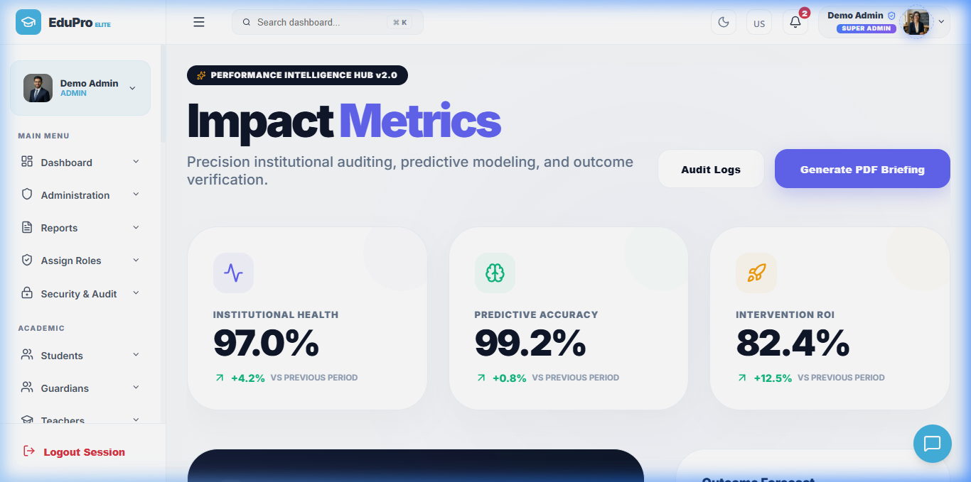
AI MODULE & NEURAL ANALYTICS HUB
Implementing the AI Intelligence Hub
• Model training simulator: React handlers execute mock epoch training to recalculate coefficients and regression weights.
• Audit Logging system: Registers prediction occurrences, model deployments, and critical risk logs on state changes.
• Student grading predictor: Queries past assignment records, LMS clicks, and exam marks to flag academic failures.
• Predictive analytics views: Shows forecast lines and risk alert matrices using Recharts curves.
AI Neural Performance Hub Page
Figure 9.1: Live AI Performance Hub interface displaying active modeling statistics, audit log streams, and training epoch gauges.

Slide 14
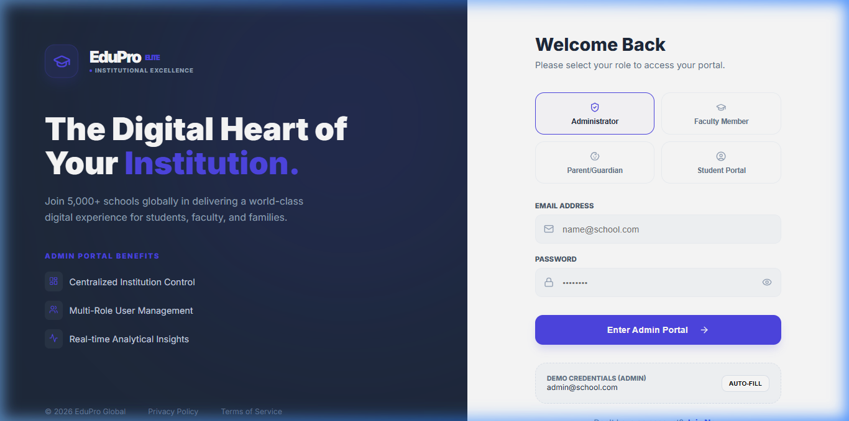
PHASE 9: SECURE LOGIN GATEWAY
Authentication & Sandbox Access Controls
• Role Tabs selection: Users toggle between Administrator, Faculty, Student, and Parent logins to set current states.
• JWT API validation: Submits credentials to backend `/api/login` and triggers localStorage tokens caching.
• Built-in Demo Bypass: Allows sandbox access for evaluators. Matches demo emails (e.g. admin@school.com) and password 'demo123' if local MySQL services are disconnected.
• Interactive toast notifications: Provides floating alerts with Framer Motion animations to indicate success or invalid credentials.
Login Portal Web Interface
Figure 10.1: Widescreen Login screen with role selection tabs, input filters, and active session verification cards.

Slide 15
TESTING & QUALITY ASSURANCE
Postman API Tests
• Endpoint verification: Tests REST payloads for CRUD actions (students, notices, transport).
• Status code validation: Ensures unauthorized actions fail with 401/403 errors, and correct inputs return 200 OK.
• JSON structures audit: Checks API response structures to match client interfaces.
Jira Project Tracking
• Agile sprint boards: Creates epics (Authentication, Academics, Financials) to track development progress.
• Task backlogs: Logs feature requirements as stories and tracks bugs systematically.
• QA workflows: Moves issues from backlog to 'In Progress', 'Testing', and 'Done' columns.
MySQL Integrity Auditing
• Relationship checks: Ensures database tables match foreign key assignments correctly.
• Null parameters check: Validates field configurations (e.g. dob, phone) fail safely when null inputs are passed.
• Cascade validations: Tests orphan records deletions on parent table modifications.

Slide 16
DEVELOPER SETUP & LAUNCH GUIDE
Local System Setup Steps
• 1. Start Database Server: Launch XAMPP/Laragon, start Apache & MySQL. Ensure port 3306 is open.
• 2. Configure Backend: Navigate to backend folder, create .env file, specify database credentials, and install dependencies (`npm install`).
• 3. Boot API Gateway: Run backend (`npm run dev` / `node server.js`). Auto-seeder initializes tables and mock records on port 5000.
• 4. Build Frontend: Navigate to frontend, run `npm install`, then start client dev server (`npm run dev`).
• 5. Access Application: Open browser to http://localhost:5173. Log in with admin@school.com (password: demo123).
// Local Config Files (.env)
# backend/.env - Environment variables
PORT=5000
DB_HOST=127.0.0.1
DB_USER=root
DB_PASSWORD=
DB_NAME=school_db
JWT_SECRET=supersecretkey123
# frontend/.env - Client configuration
VITE_API_URL=http://localhost:5000/api
# Quick check commands in terminal
cd school-management-backend && npm run dev
cd school-management-frontend && npm run dev

